Slide 1
COMPUTER SECURITY
Introduction

Slide 2
What is Computer Security?
Keeping the computer system's information secure.
Controlling access to hardware, software and data of a computerized system.

Slide 3
What is Computer Security?
The protection afforded to an automated information system in order to attain the applicable objectives of preserving the integrity, availability and confidentiality of information system resources (includes hardware, software, Information/data, and telecommunications)

Slide 4
Computer Security Goals
To prevent the weakness from being exploited while preserving three very important aspects
Confidentiality
Integrity
Availability

Slide 5
Confidentiality
To ensure that computer related assets are accessed only by authorized parities and the authorized parities actually access the required assets
This type of access includes:
    Printing
    Displaying

Slide 6
Integrity
To ensure that different assets can be modified only by authorized parities or only by authorized means
Modification includes:
    Writing
    Changing
    Changing status
    Deleting and Creating

Slide 7
Availability
Availability requires that computer system assets are available to authorized parties at appropriate time and not Prevented through this time.
Service is not denied to authorized users.

Slide 8
Access Control
Unauthorized users are kept out of the system.
Unauthorized users are kept out of places on the system/disk.
Objects: Resources that need to be protected
Subjects: Entities that need access to resources
Rights: Permissions

Slide 9
Usability and Security
∝
Determine where on this line your organization needs lie
Convenience / Usability
0
Security
∝

Slide 10
Definitions
Intruder : is the one who exploit any available mean of penetration to penetrate a system.
Vulnerability: is a weakness in the security system (i.e, design, implementation..etc. any point can be exploited to cause loss or harm to the system)
Threat: is a set of circumstances that has the potential to cause harm or loss

Slide 11
Definitions
Attacker: is the one who exploit the vulnerability to penetrate the system (attacker must have MOM)
  Method: tools and knowledge
  Opportunity: time and access
  Motive: strong reason for attack
Control: is an action, device, procedure, or technique that removes or reduces a vulnerability
Threats are blocked by control of Vulnerability

Slide 12
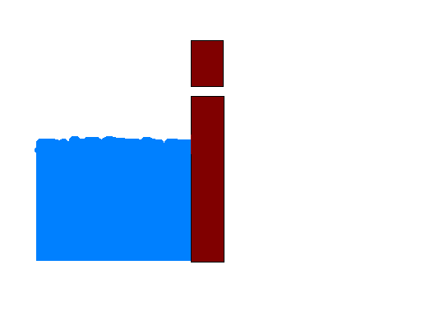

Difference between Threat and Vulnerability
“Vulnerability”
Crack in the wall
  “Threat”
  Wateroverflow

Slide 13
Type of Threats in Computer Systems
A threat:
  is a danger which could affect the security (confidentiality, integrity, availability) of assets, leading to a potential loss or damage.
Threats are being in four types:
Interruption
Interception
Modification
Fabrication

Slide 14
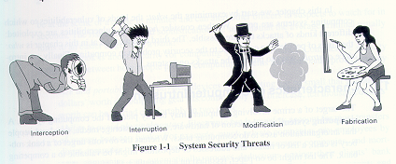

Slide 15
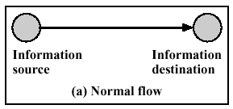
Normal Flow of Information

Slide 16
Interruption
An asset of the system is destroyed or becomes unavailable or unusable.
This is an attack on the availability.
Examples:
  destruction of a piece of hardware, such as a hard disk, the cutting of a communication link,
  the disabling of the file management system.

Slide 17
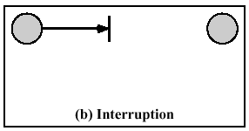
Interruption

Slide 18
Interception
Information disclosure/information leakage
An unauthorized party gains access to an asset.
This is an attack on confidentiality.
The unauthorized party could be a person, a program, or a computer.

Slide 19
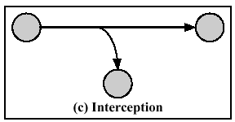
Interception

Slide 20
Modification
An unauthorized party not only gains access to but tampers with an asset.
This is an attack on the integrity.
Examples:
  changing values in a data file
  altering a program so that it performs differently
  modifying the content of a message being transmitted in a network.

Slide 21
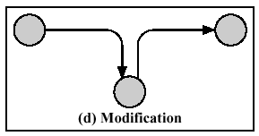
Modification

Slide 22
Fabrication
An unauthorized party not only accessed the asset but also tampered it,
This is an attack on the authenticity.
Examples:
  the insertion of messages in a network
  the addition of records to a file.

Slide 23
Classification of Attacks
Computer Security attacks can be classified into two broad categories:
  Passive Attacks can only observe communications or data.
  Active Attacks can actively modify communications or data. Often difficult to perform, but very powerful.

Slide 24
Principles of Network Security

Slide 25
What Makes a Network Vulnerable?
1- Anonymity (no personal identification):
An attacker can mount an attack from thousands of miles away and never come into direct contact with the system.
2- Many points of attack both targets and origins:
A large network offers many points of vulnerability.
3- Sharing:
Networks enable resource sharing, so more users have the potential to access networked systems than on single computers.

Slide 26
What Makes a Network Vulnerable?
4-Complexity of system:
A network combines two or more possibly dissimilar operating systems.
5-Unknown network boundary:
A network's expandability implies uncertainty about the network boundary. One host may be a node on two different networks, so resources on one network are accessible to the users of the other network as well.
6-Unknown path.
there may be many paths from one host to another. The message might be routed through different hosts before arriving at destination host.

Slide 27
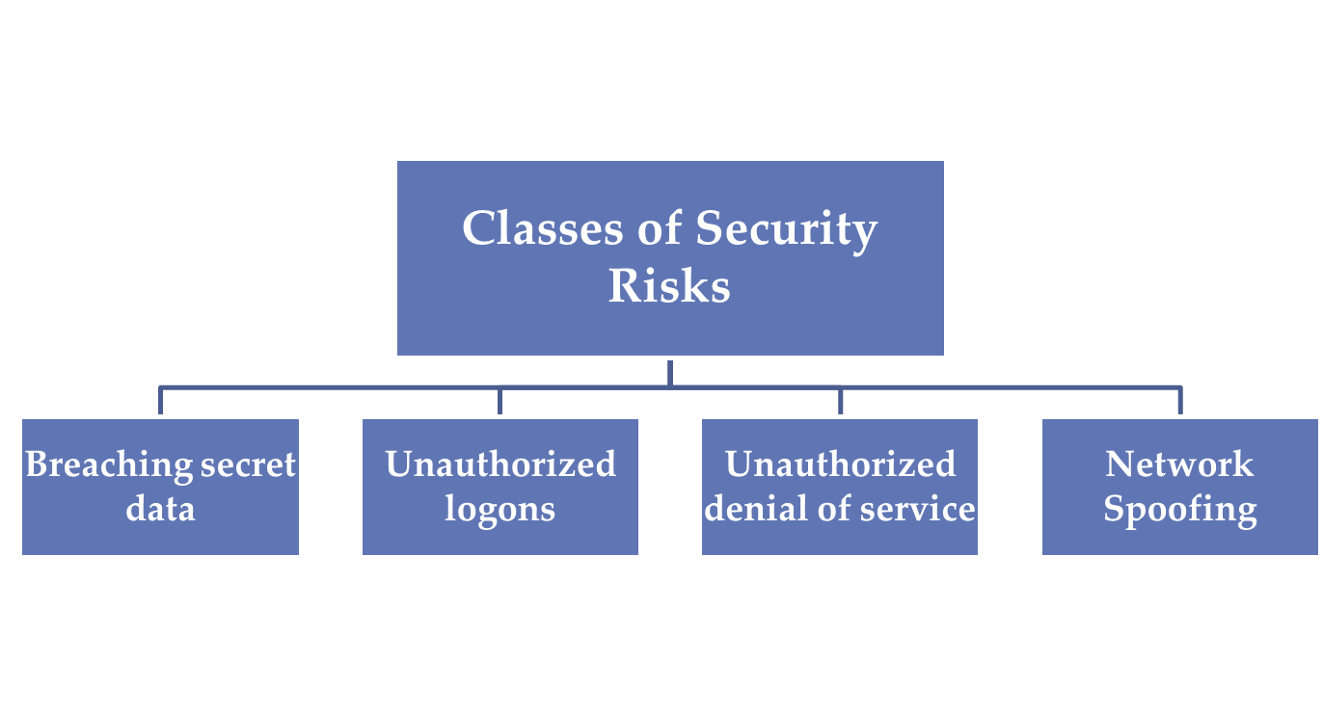

Slide 28
Breaching secret data:
Confidential data is often stored and transmitted in encrypted form weak encryption lead to data breaching.
Unauthorized logons:
results from misuse of stolen and guessed passwords, lack of authentication
Unauthorized denial of service:
the hacker is interested in shutting down the computer system, degrading its performance, consuming its resources i.e.
Network Spoofing:
occurs when one host on the network is used to impersonate another host

Slide 29
Network Security Concepts
Identification:
  user ID for each application.
Authentication:
  verification of the identity of user (password one-way authentication, application to user is two-way authentication)
Authorization:
  is the process of assigning access to each user ID (access rights include read, write, update)

Slide 30
Confidentiality:
  the process used to protect secret information from unauthorized disclosure.
Data integrity:
  allows detection of unauthorized modification of data (even through transmission)
Non repudiation:
  is the capability to provide proof of the origin of data or proof of the delivery of data
Denial of Services:
  when attacker consumes a resource so that no one else can use it.

